Slide 1
Option 1

Slide 2
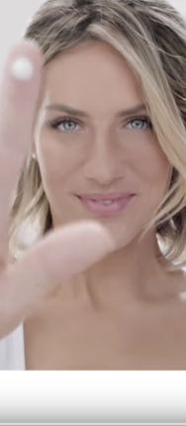
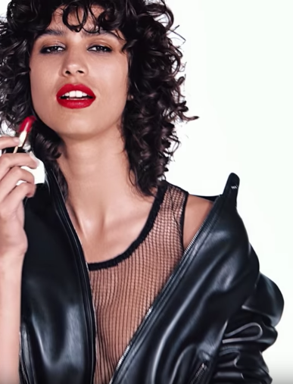
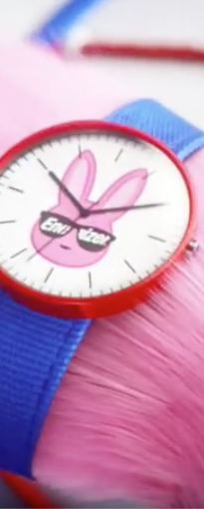
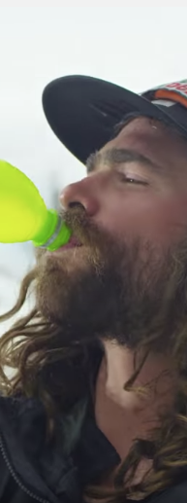
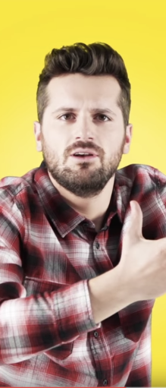







Six Second Anatomy:
How to get started
0:01/0:06
INTERNAL: Google Confidential and Proprietary

Slide 3
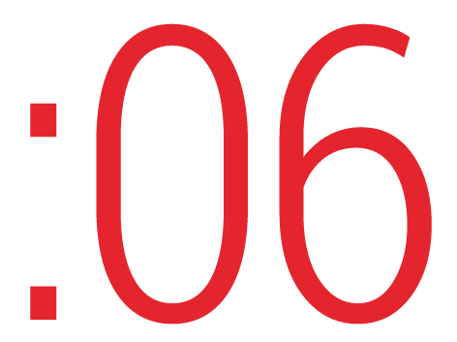
There’s a new video format in town - Six second ads! After reviewing hundreds of them, we identified 5 creative insights for making the most of your 6 seconds. Consider this your anatomy lesson....

Slide 4
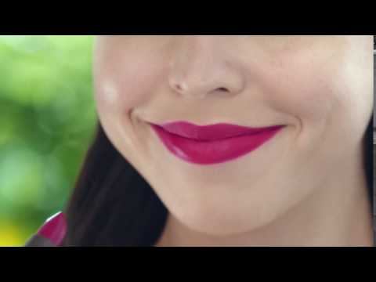

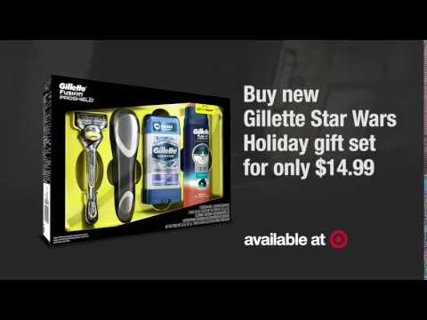
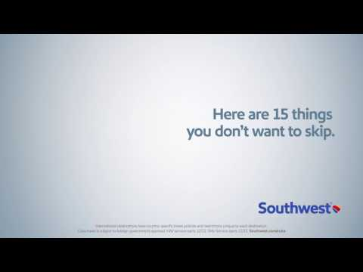
Focus, Focus, Focus
When it comes to six second ads, simplicity is key. They can do one thing well, two things ok, and three things? Don’t even try.
Focus on one purpose for your ad and then deliver on that. Don’t be tempted to balance bits like you do in a 30: a little story, a little product, a little branding, then an offer at the end for good measure.
The shorter the time, the greater the focus. Consider whether you really need an end card at the end with your tagline and logo, as they aren’t on screen long enough to absorb. Similarly, the call to action overlay may be too distracting from your singular focus. Instead, try having your branding throughout the Six Second Ad or strategically placed in the middle so it can be absorbed. Pick one thing to do really well and then give that the focus and air time it needs to deliver.
Burt’s Bees: one feature Miller: one shot
examples:
Target & Gillette: one offer Southwest: one joke
Notes:
Implication:

Slide 5
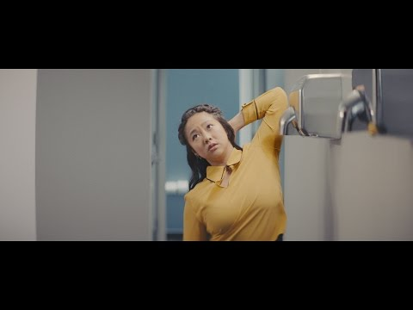
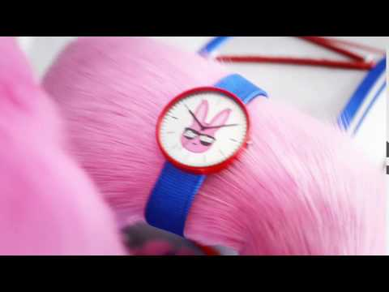

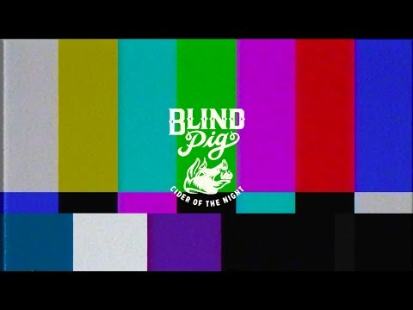

Establish the ad
Picture this: you’ve clicked a video and you’re waiting for it to play. It starts, but you’re not sure what you are seeing: is it your video? Is it an ad? And if it’s an ad, what’s it for and can I skip it?
Six second ads are user friendly but it’s still important to establish the ad to the viewer. This can mean having a strong or striking visual focus at the start, then building your story around that. Or it can be a single subject (check out Secret) or even a visual signal that the viewer is now in the brand’s space.
What to avoid? In the first second or two, don’t include information that is critical to understanding your ad. In those moments, the viewer is still trying to figure out what’s going on.
Secret: visual focus Energizer: visual focus
examples:
Trading 212: ad signal Blind Pig: ad signal
Notes:
Implications:

Slide 6
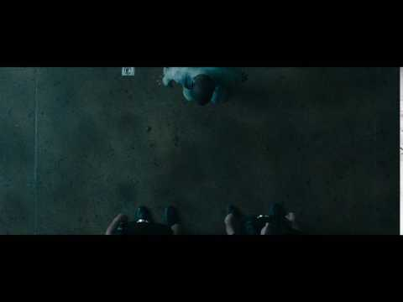
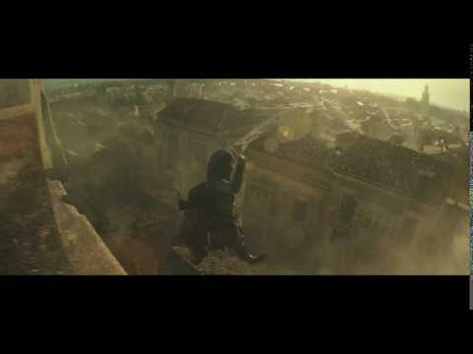
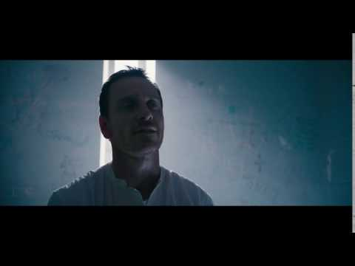
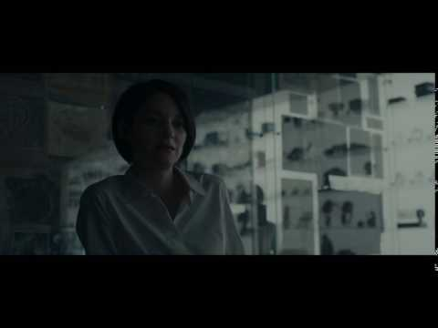
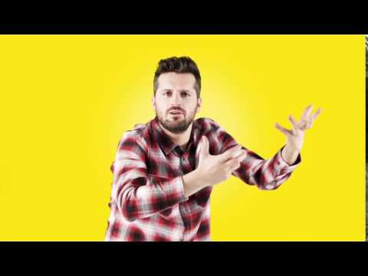
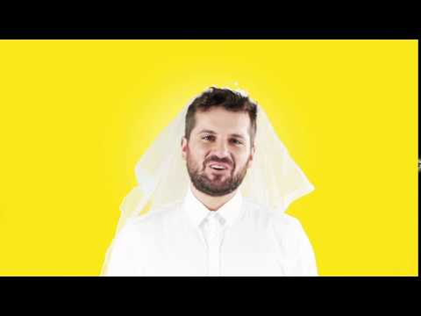
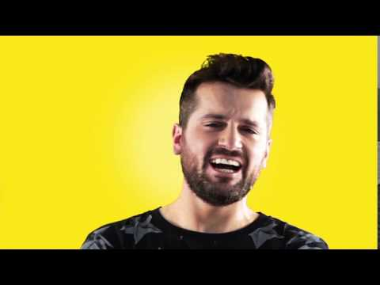
A Flock of :06s
After establishing the ad, you may want to deepen the story. One approach is to make a series of ads, a flock of :06s if you will.
Think of them as a set of 3-5+, not just one single unit that you hope will accomplish everything. This opens up what you can focus on and expect from each one. If you create the expectation of what they’ll see (the same kind of joke, but not the same joke), you can pull them in quicker, with more impact.
Try breaking the story into chapters or go deep on different facets: think differently about how impact is created. Six second ads are little touches that add up, rather than a complete novel delivered in one sitting.
Once you expand beyond one unit, you can dream up new ways to use other ad formats, such as display ads or longer video ads, as complements to extend, amplify, or echo what you presented in the original ad.
Assassin’s Creed Trailers
examples:
Twix
Notes:
Implications:

Slide 7


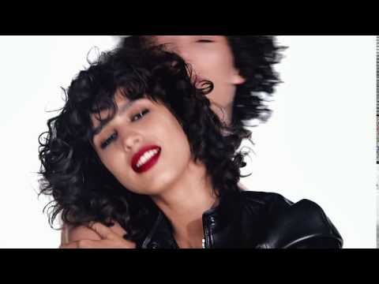

Think outside the :30
Let’s not beat around the bush. It’s tough to cut down a :30 into a powerful and coherent 6 second ad. However, this opens you up to look beyond the 30 second creative for inspiration.
For one, six second ads can be a great amplification of a print ad. Think simple, striking visuals or a headline with music. This can be very effective in 6 seconds, whereas a more complex ad with storytelling can be a struggle.
They can also be used to amplify other awareness media. Canada Goose, Jack Daniels, Tom Ford and more recognize that using concepts built on or leveraging print and other media ideas can be as fruitful as trying to cram your TV ad into six seconds.
Canada Goose Jack Daniels
examples:
Tom Ford Immodium (Russia)
Notes:
Implications:

Slide 8

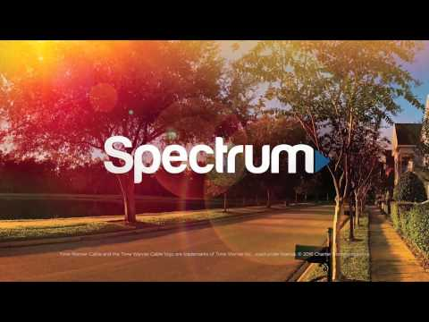

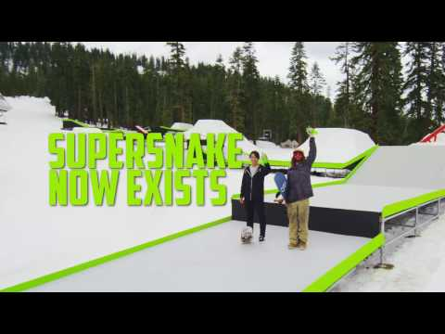
Stick the landing
Execute flawlessly and end memorably by reinforcing what you want the viewer to remember (and act on).
Too often Six second ads feel rushed at the end, whether it’s trying to stuff in a TV end card, put up a brand logo, or speed their way through your tagline and offer.
Stick the landing by leaving the viewer with just one thought, clearly expressed or easy to read, and give it enough time to sink in. That means more than a fraction of a second.
Remember it’s better to do less and do it well (especially at the end) than to rush.
Neutrogena Time Warner
examples:
HostGator Mountain Dew
Notes:
Implications:

Slide 9

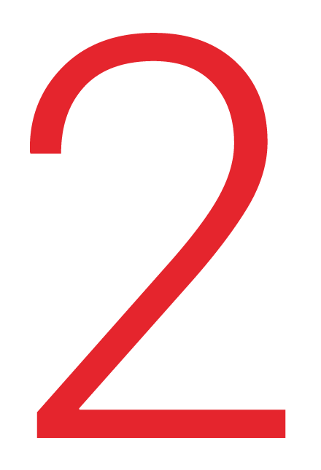
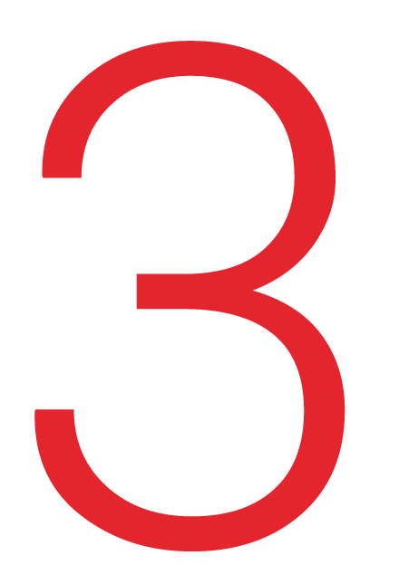
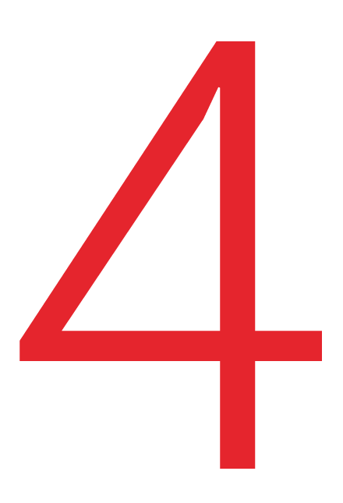
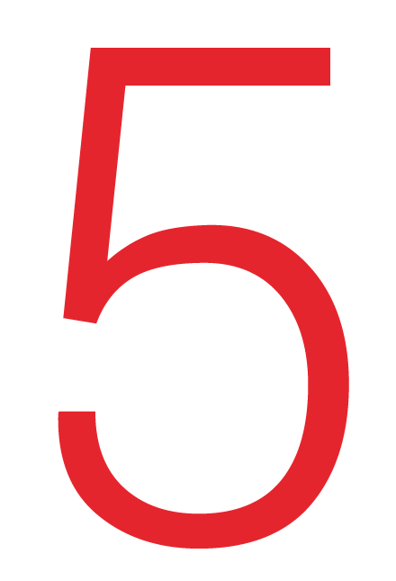
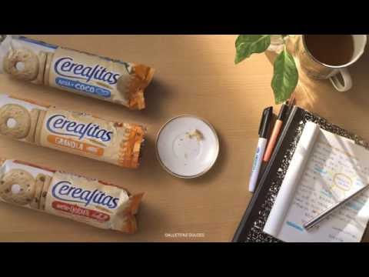
Six Second Creative Insights
Lessons Learned from Six Second Ads
Focus, Focus, Focus
Establish the ad
A flock of Bumpers
Think outside the :30
Stick the landing
Focus on one purpose for your ad and then deliver on that. Don’t be tempted to balance bits like you do in a :30.
The shorter the time, the greater the focus. So pick one thing to do really well and then give that the focus and air time it needs to deliver.
Six second ads are user friendly but it’s still important to establish the ad to the viewer. This can mean having a striking visual focus at the start, having a single subject, or giving a signal that the viewer is now in the brand’s space.
Don’t include information that is critical to understanding your ad in the first few moments.
Think of Six second ads as a set of 3-5+, not just a single unit you expect to accomplish everything. Try breaking the story into different chapters or go deep on different facets.
They are little touches that add up. Go beyond one unit and use other formats alongside to extend, amplify, or echo.
Look beyond the 30 second creative for inspiration. Six second ads can be a great amplification of a print ad or other awareness media, with simple visuals and a striking headline with music.
Use a concept built on or leveraging print & other media ideas instead of a complex story that struggles to cram everything into 6 seconds.
Execute flawlessly by reinforcing what you want the viewer to act on and remember. Too often Six second ads feel rushed at the end with logos, end cards, or taglines.
Leave the viewer with just one thought that is clearly expressed, with enough time to sink in. Remember it’s better to do less and do it well than to rush.

